Slide 1
AI REGULARIZATION
By
Cronic7

Slide 2
TABLE OF CONTENTS
01
03
02
04
Introduction
Demo code
Types of Regularization
Q/A

Slide 3
01
INTRODUCTION

Slide 4
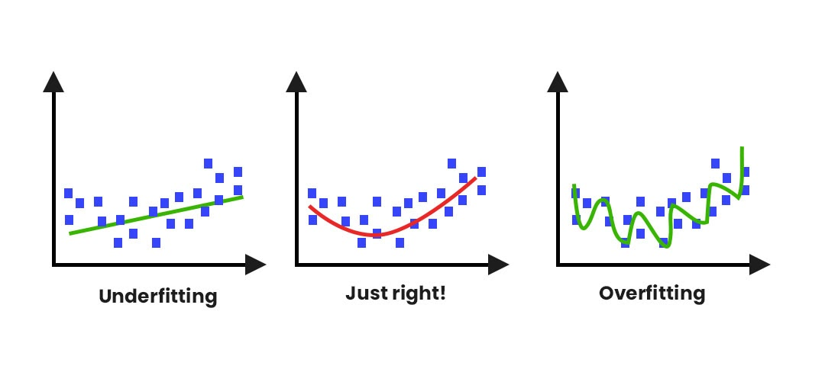
REGULARIZATION
The word regularize means to make things regular or acceptable.
Regularization is a method to balance overfitting and under fitting a model during training.
Both overfitting and under fitting are problems that ultimately cause poor predictions on new data.

Slide 5
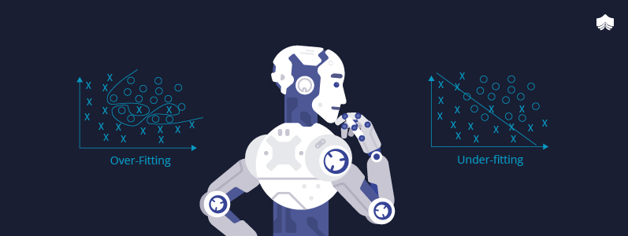
Overfitting
Overfitting occurs when a machine learning model is tuned to learn the noise in the data rather than the patterns or trends in the data.
Models are frequently overfit when there are a small number of training samples relative to the flexibility or complexity of the model.
Such a model is considered to have high variance or low bias.

Slide 6
Underfitting
Underfitting occurs when the machine learning model does not capture variations in the data – where the variations in data are not caused by noise.
Such a model is considered to have high bias, or low variance.

Slide 7
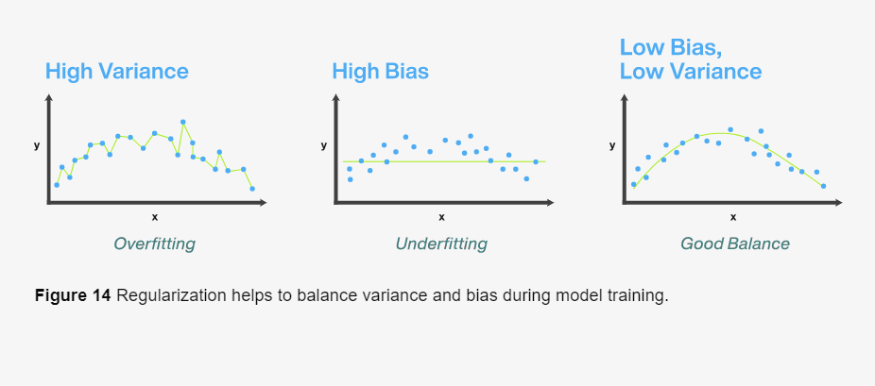
Example of Regularization

Slide 8
02
Types Of Regularization

Slide 9

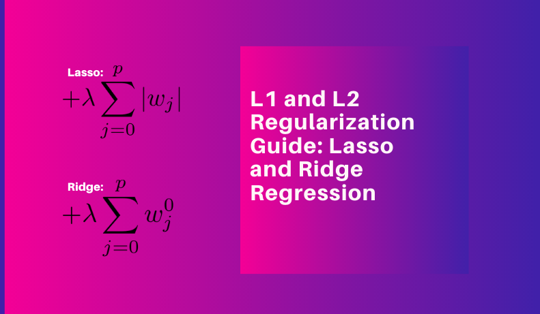
Types Of Regularization
L1 Regularization
L2 Regularization
A linear regression model that implements L1 norm for regularization is called lasso regression.
A linear regression model that implements (squared) L2 norm for regularization is called ridge regression.

Slide 10
L1 Regularization
The regression model that uses L1 regularization technique is called Lasso Regression.
Lasso Regression stands for (Least Absolute Shrinkage and Selection Operator).
It adds “absolute value of magnitude” of coefficient as penalty term to the loss function.
L1 regularization adds the penalty term in cost function by adding the absolute value of weight(Wj) parameters

Slide 11
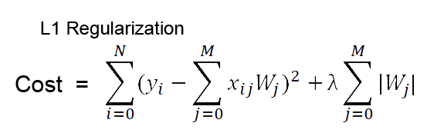
Where 𝝺 is called the regularization parameter.𝝺=0 then the above loss function acts as Ordinary Least Square where the high range value push the coefficients (weights) 0 and hence make it under fits.

Slide 12
L2 Regularization
The model which uses L2 regularization is called Ridge Regression.
Ridge regression adds “squared magnitude” of coefficient as penalty term to the loss function.
It adds “absolute value of magnitude” of coefficient as penalty term to the loss function.
L2 regularization adds the squared value of weights(Wj) in the cost function.

Slide 13
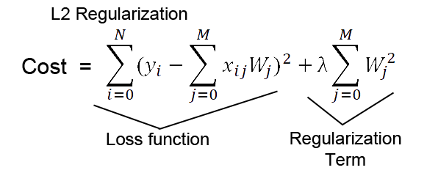
Here, 𝝺 is known as Regularization parameter, also if the lambda is zero, this again would act as OLS, and if lambda is extremely large, it leads to adding huge weights and yield as underfitting.

Slide 14
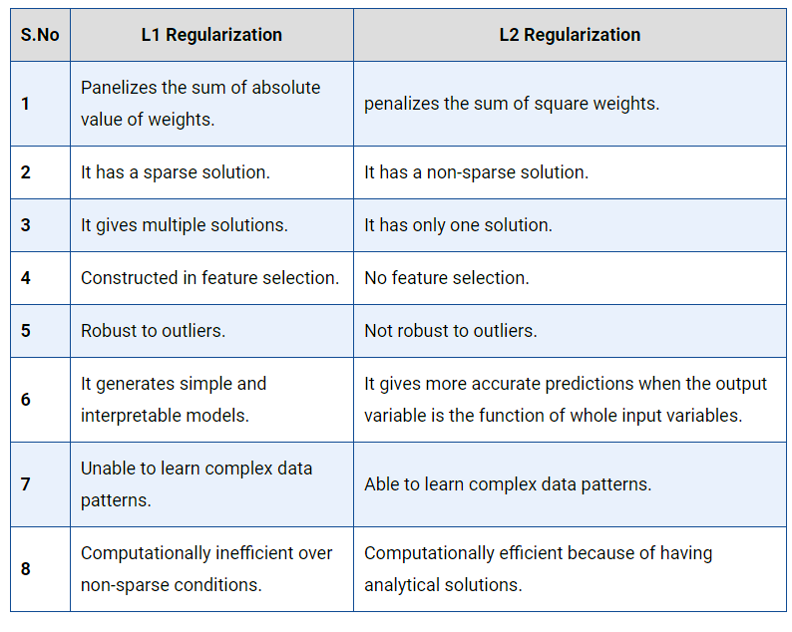
Difference between L1 and L2.

Slide 15
03
Demo Code

Slide 16
Demo Code
Demo of L1 and L2 regularization

Slide 17
04
Q/A

Slide 18

Q/A

Slide 19
THANKS!

